Slide 1

WHEAT International Trial (UK) –Training Slides (Brief)
WHEAT Trial
WithHolding Enteral feeds Around blood Transfusion – the WHEAT International Trial
Notes:
This is a short training video, which should last around 15 to 20 minutes, designed to give site staff a brief overview of the WHEAT International Trial, which is Sponsored by Imperial College London. In the interests of keeping this concise and succinct, the focus is on eligibility, consent, recruitment and trial procedures and is intended to be reviewed along with the Trial Protocol and Trial Procedures Guide.

Slide 2
Study Objectives
Primary Objective: To determine if withholding enteral feeds around blood transfusion is superior to continued enteral feeding, in reducing incidence of NEC (≥ Stage II) and other adverse clinical outcomes before discharge from neonatal care.
Secondary Objectives: Is withholding enteral feeds around blood transfusion superior to continued enteral feeding, in reducing incidence of the following clinical outcomes before discharge from neonatal care?
Severe NEC
Death
Late-onset sepsis
Number of days with central venous line in-situ
Number of central line associated bloodstream infections
Duration of parenteral nutrition (in days)
Growth: Weight & head circumference z-score
Spontaneous intestinal perforation
Duration of neonatal unit stay (in days, all levels of care)
Bronchopulmonary dysplasia/Chronic Lung Disease

Slide 3
Trial Procedures – Patient Identification
Patient Identification & Eligibility
Badger has been configured to (partially) automatically detect an eligible baby based on the routine age data entered into the Admission Summary.
No screening of admission lists required.
Inclusion criteria
Preterm birth at <30+0 gestational weeks + days
Exclusion criteria
Parent(s) opt-out of trial participation.
Packed red cell transfusion with concurrent enteral feeds prior to enrolment. Infants who have received a packed red cell transfusion while nil-by-mouth or minimal enteral nutrition (<15ml/kg/day feeds) – 4hrs either side of transfusion - are eligible.
Infants not being fed at the time of randomisation or where enteral feeding is contraindicated, for example major congenital abnormality of the gastrointestinal tract.
Previous episode of necrotising enterocolitis (NEC) or spontaneous intestinal perforation (SIP) prior to first packed cell transfusion.
Notes:
Q: Can we randomise babies that are considered high-risk (i.e. a 380g preterm (<30wks)), but still meet the eligibility criteria?
A: Yes, if the clinician has equipoise to randomise then they should, but if they do not feel that it is appropriate for clinical reasons – then they clearly should not. We are very happy to be contacted about such babies though if helpful and to advise on what other units have done.
Q: What constitutes a previous episode of NEC?
A: If it would meet the threshold for reporting to the National Neonatal Audit Programme (NNAP)
Q: Would a baby still be eligible if the NEC/SIP is prior to the 2nd or any other blood transfusion before enrolment?
A: Our primary outcome is the development of NEC, so if a baby has had NEC (or SIP) reported as a NNAP outcome at any point prior to enrolment – please do not include these babies in the trial.
Q: If a baby had a previous transfusion(s) where enteral feeds were paused or reduced to <15ml/kg/day for the duration of the transfusion only, are they still eligible for the trial?
A: No. Only if a baby was nil-by-mouth (NMB) or was receiving feeds <15ml/kg/day around the time of the previous transfusion (4 hours before, during and 4 hours after prior transfusion(s)) would they be eligible for the trial.
Bear in mind that in its’ current iteration, Badger only flags a baby as eligible based on the inclusion criteria alone. So, it may flag a baby as eligible but actually that baby was fed during a previous transfusion or had NEC and so I will explain in a moment how to circumvent that.

Slide 4
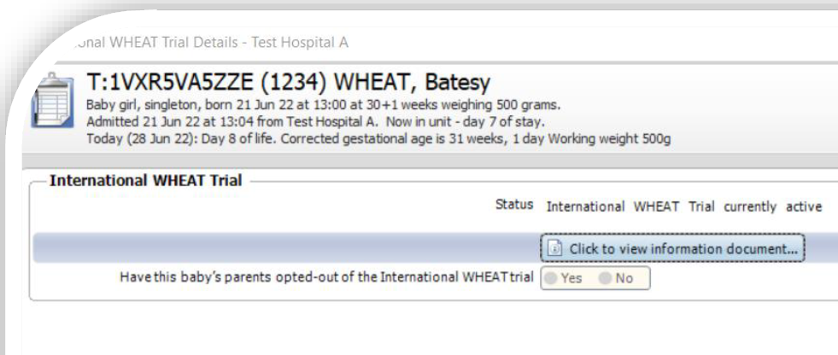
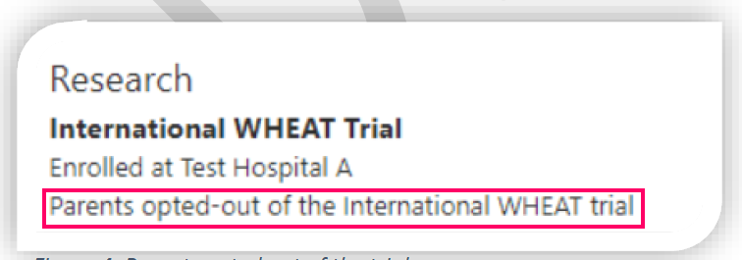
Trial Procedures – Opt-Out Consent
Badger Patient Summary
Informed opt-out consent
Nurses can present the trial to parents/guardians
  GCP not required (only for PI and Core Research Team)
  Must have received trial training i.e. this video
Localised Parent Information Sheet can be accessed Badger
Use the Opt-Out Consent Guide to cover the main points
Briefly record the conversation in EPR or in the paper notes
Record the outcome in Badger
Update Screening & Enrolment Log

Slide 5
Trial Procedures – Randomisation
Timing of Consent & Randomisation
We recommend you to have the opt-out participation discussion with the parent(s)/guardian(s) of an eligible baby as soon you feel it is appropriate
  Babies must be ≤ 34+6 (weeks+days) post-menstrual age to be randomised
However, please do not randomise until the baby requires a non-emergency blood transfusion
Remember that the ‘withhold feeds’ arm of the trial will require feeds to be withheld at least 4 hours prior to each transfusion
Do not delay emergency transfusions!
  Record these as eligible babies not randomised on the Screening & Enrolment Log
Use the Cot Cards – Eligibility and Paper Notes Eligibility Labels

Slide 6
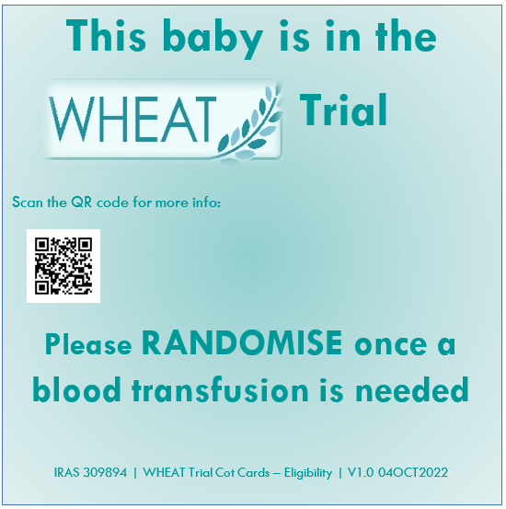
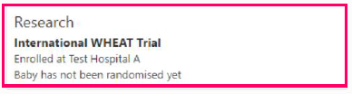
Trial Procedures – Randomisation
Timing of Consent & Randomisation
Attach these cards to the cot of an infant eligible for the WHEAT Trial, but not yet randomised as they currently do not require a blood transfusion
The QR code links to the trial website for further information on the WHEAT Trial
Alerts will also be built into the Patient Summary on Badger:

Slide 7
Documenting Presentation of Information to Parents/Guardians
EPR/Paper Notes Documentation
Date: _____/____/______
Parents/guardian provided with a copy of the WHEAT Parent Information Sheet (IRAS 309894, V2.0 21 JUN 2022) and they had no objection to their baby’s enrolment in the trial.
Staff Member signature: ___________________________
Please add a note to the Parental communication
Title: Wheat trial communication
Please see your email with study details to be enter on the patient EPR

Slide 8
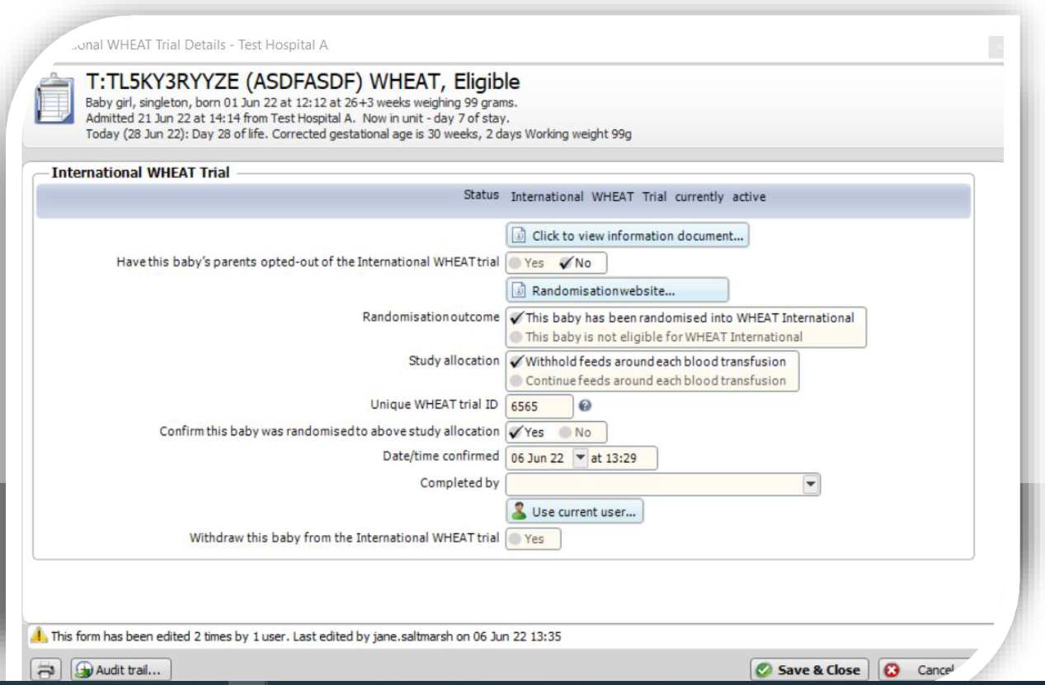
Trial Procedures – Randomisation
Randomisation
Only once you have presented the trial information to parents
Enrolment can take place any time before 35 (weeks + days) post-menstrual age
  Badger will not allow you to proceed if baby’s age precludes enrolment
  Double-check that baby has not had a previous transfusion with concurrent enteral feeds, nor have they developed NEC/SIP
Multiple births will be randomised to the same arm
Link to randomisation website provided within Badger to make randomisation as simple as possible
Notes:
Now, I mentioned before about babies who flag as eligible but on further review are not. In this instance – select “No” to the opt-out question and then select “This baby is not eligible” to the Randomisation outcome. We realise this is not necessarily a true representation of the facts and will seek to update this, but this will prevent your team from approaching parents of a baby who is not suitable for inclusion.

Slide 9
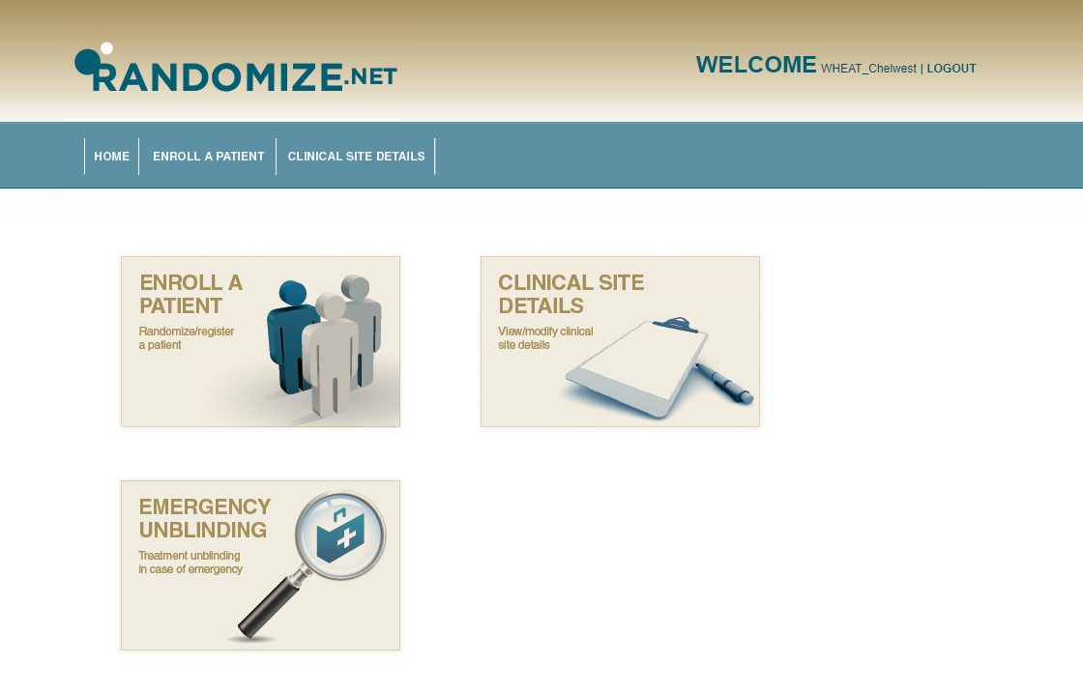
Randomisation access
Randomisation: Step by step
1. Click on the link to open the website: https://randomize.net/
2. Click to sign in (right top corner)
3. Enter generic login
Username: as per email from Trial Manager
Password: as per email from Trial Manager
4. Enrol a patient and confirm eligibility
5. Randomise eligible patient
6. Implement intervention and document it on EPR/Paper Notes

Slide 10
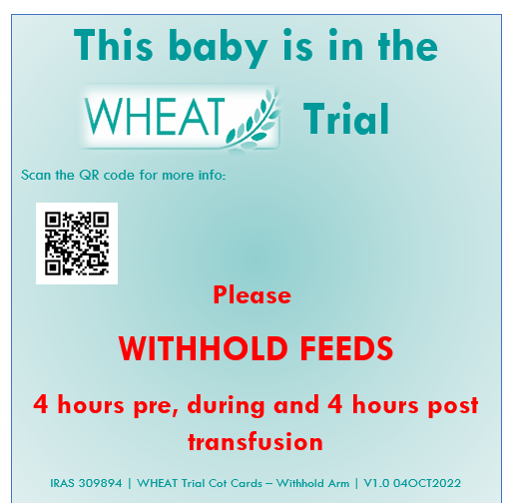
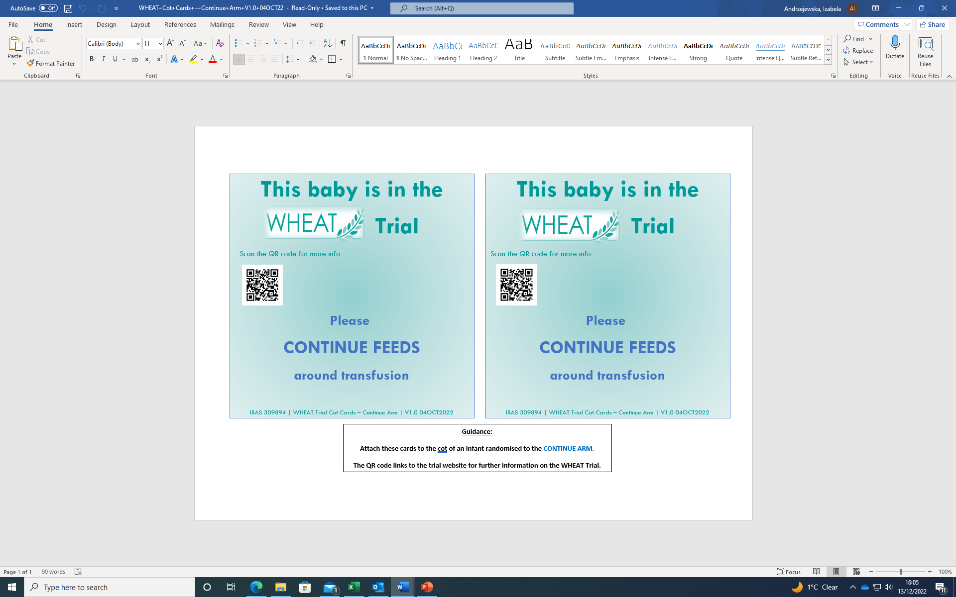
or
Post Randomisation
Please use allocated post randomisation the cot card
Randomisation

Slide 11

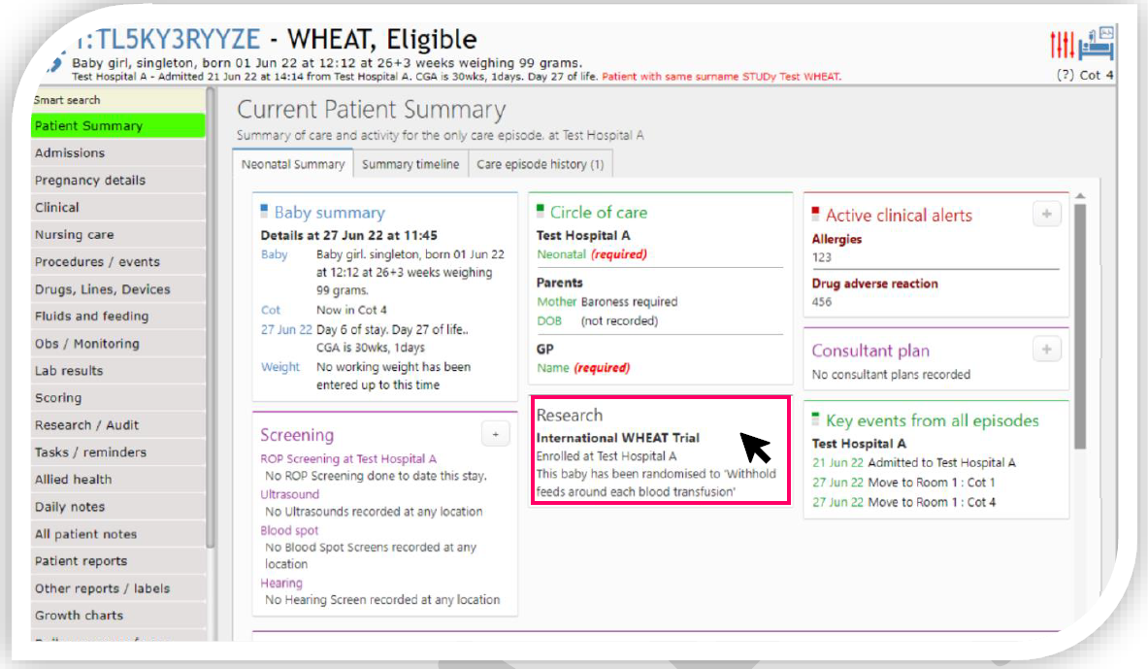
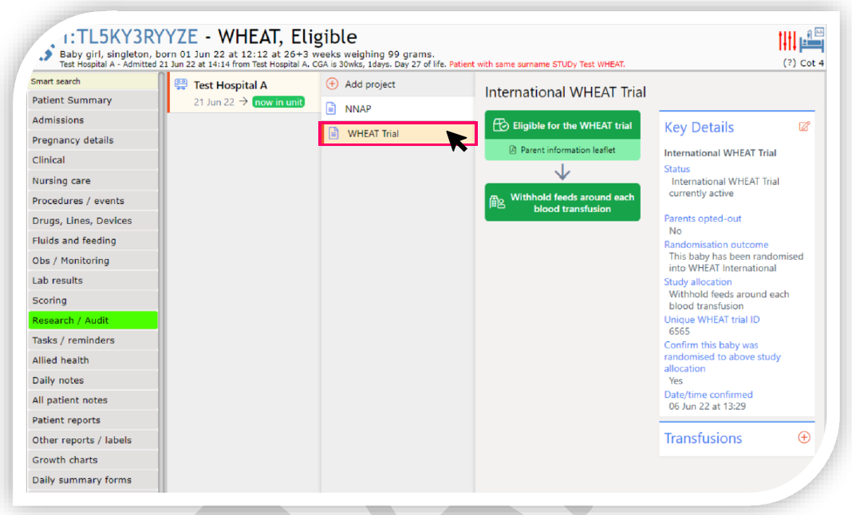
Trial Procedures – Randomisation
Randomisation Outcome
Patient Summary view:
Research/Audit view:

Slide 12
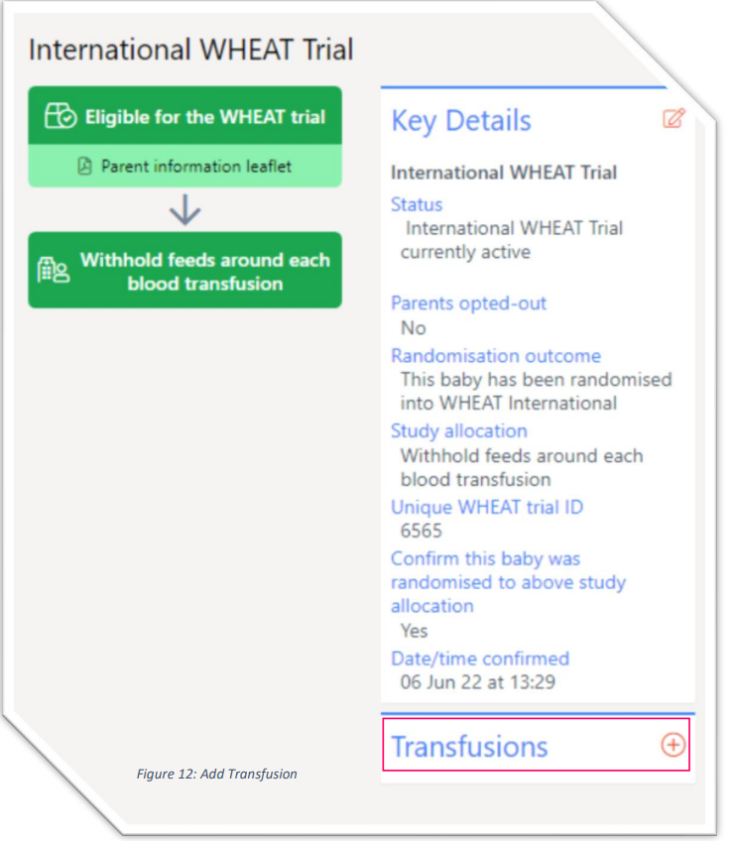
Trial Procedures – Intervention
Trial Intervention
CONTINUE FEEDS
Enteral feeds will continue to be given prior, during and after the packed red cell transfusion, in the manner in which they were being given prior to the decision to transfuse – at the same rate and type of milk and concentration of fortifier as used before the decision to transfuse.
WITHHOLD FEEDS
At least 4 hours prior, during and after packed red cell transfusion (~11-12 hours total)
hydration and blood glucose will be maintained according to local practice, commonly by providing parenteral nutrition or intravenous dextrose
At least 4 hours after the red cell transfusion has finished, feeds will be recommenced in the manner they were being given prior to the decision to transfuse – at the same rate and type of milk and concentration of fortifier as used before the decision to transfuse
Infants will remain allocated to the same care pathway until 35 weeks post-menstrual age.
Notes:
Q: With regards to the continue feed arm of the protocol where it states ‘the same rate and type of milk and concentration of fortifier as used before the decision to transfuse’, do you consider the ‘rate’ to be the baby’s total daily fluid volume (such as 165ml/kg/day) to remain the same, and not also the hourly volume? Instances such as where the baby remains on 165ml/kg/day, but the hourly volume increases due to the baby’s working weight being adjusted, is this ok as we are keeping the total daily volume the same?
A: Yes, we consider the ‘rate’ to be the total daily feed volume in ml/kg/day and not the hourly volume.
Q: If, for example the baby is due to increase the enteral feed total daily volume (as normal NICU practice), for example at 12:00 they are on 30ml/kg/day but due to increase to 50ml/kg/day at 13:00, but they are having their transfusion in the afternoon, when would it be acceptable to increase that baby’s total daily volume as the protocol states ‘the same rate’? Does it have to be a certain time after the transfusion?
A: It is absolutely acceptable to increase the feed volume as planned after the transfusion as you describe here. What we are trying to prevent is units restarting feeds at ¼ the previous volume, or restarting feeds with diluted milk, or any other graded reintroduction of feeds.
Q: How should we manage fluids and blood sugars?
A: As the trial is pragmatic we are not specifying a way to manage fluids/blood sugar, especially as there are all sorts of practices going on across the country. This will be according to your local practice.
Q: Did those that with no IV access beforehand get 2 cannulas?
A: For babies on full feeds where feeds are 1 or 2 hourly and the team do not think that the baby will tolerate (from a blood sugar point of view) being NBM for 3-4 hours (depending on how long you give blood over) – these babies get a second cannula
For babies on full 3-4 hourly feeds, some sites insert the cannula 4 hours before and run 10% dextrose through it, then stop the 10% dextrose and run the blood through for 3 or 4 hours (depending on your policy) while checking blood glucose at 2 or 3 hours, then run 10% dextrose through the same cannula after the blood has finished.

Slide 13
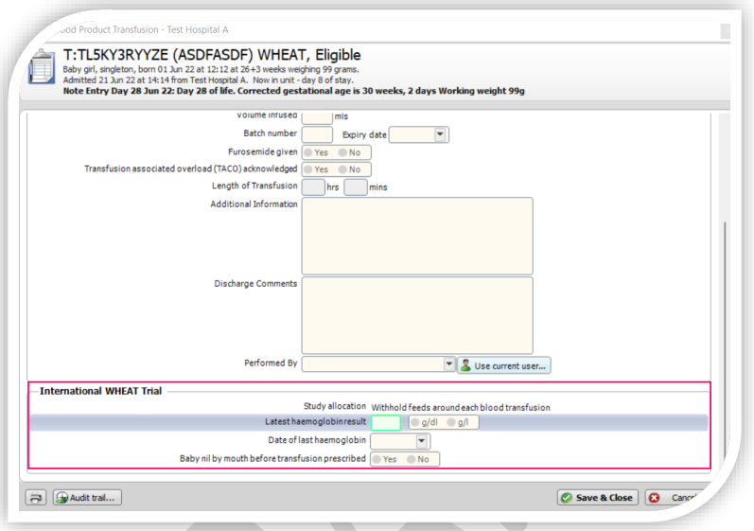
Trial Procedures – Data Collection
The following fields are additional and need to be completed for each transfusion during the trial intervention period:
Latest haemoglobin result (g/L or g/dl)
Date of last haemoglobin result
Baby nil by mouth before transfusion prescribed (Y/N)
  N.B. When toggled to No, an additional field – Enteral feeds paused before, during and after the transfusion – is surfaced with a mandatory Yes/No toggle.
Save & Close.

Slide 14
Trial Procedures – Data Collection
Intervention – Data Collection
Infants will remain allocated to the same care pathway until they reach 35 weeks post-menstrual age
At 35 weeks post-menstrual age the choice of continuing or withholding enteral feeds around blood transfusion will be determined by the clinical team.
Follow-up data collection (routine only) until 40 weeks/final discharge
Continuing care
Randomised babies will remain on the trial if discharged to a continuing care site before they reach 35 weeks post-menstrual age
The patient record will have the WHEAT fields enabled on the Badger system used at the continuing care site
Please notify Sponsor: 0207 594 7271 when a WHEAT baby is transferred to a continuing care site
14
Notes:
Results of a qualitative evaluation

Slide 15

Safety Reporting
Safety Reporting
Identify your local Principal Investigator and Lead Research Nurse(s)
Review the safety reporting requirements in the Protocol (V1.3 13 JUN 23)
Ensure you have their contact details in case of clinical events which may need reporting to Sponsor
As a reminder, unexpected/trial-related events must be reported to Sponsor within 24 hours of the event

Slide 16

Contacts
Contact Us
Trial Manager/Monitor
Joe Montebello
WHEAT@imperial.ac.uk
0207 594 7271
Chief Investigator (UK)
Prof Chris Gale
christopher.gale@imperial.ac.uk

